Slide 1
Requirement Engineering
TELECOM Nancy 2021-2022

Slide 2
Sources
Software Engineering 10 - Ian Sommerville - Pearson
Applying UML and Patterns - Craig Larman
Software Requirements (Third Edition) - Wiegers and Beatty
Requirement Engineering – Dick, Hull and Jackson 2017 - Springer

Slide 3
Topic covered
Definition of requirements
Requirement Engineering
Requirement Process
Elicitation
Specification
Validation
Change

Slide 4
What is a requirement ?
The IEEE Standard Glossary of Software Engineering Terminology defines a requirement as:^{[1]}
A condition or capability needed by a user to solve a problem or achieve an objective.
A condition or capability that must be met or possessed by a system or system component to satisfy a contract, standard, specification, or other formally imposed document.
A documented representation of a condition or capability as in 1 or 2.
IEEE Computer Society (1990). "IEEE Standard Glossary of Software Engineering Terminology". IEEE Standard.

Slide 5
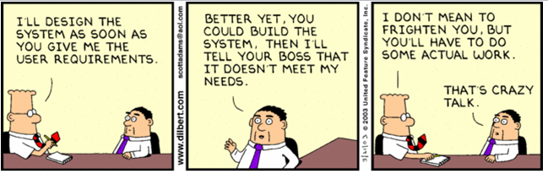
Requirements in practice
A user describes his/her needs, requirements specification to in a specification document
The software developer take the specification document and produce a piece of software thet meet these needs perfectly
What can go wrong with this story ?

Slide 6
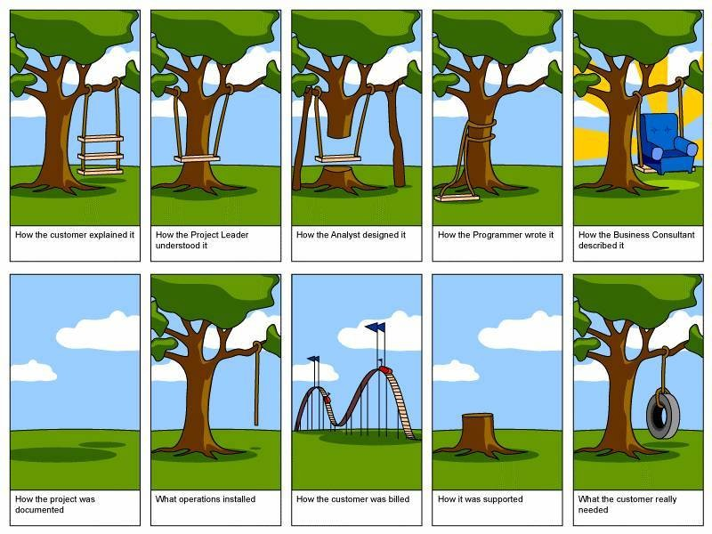

Slide 7
Requirement
Description of the required functionnality
Un client peut ajouter un produit dans son panier
Details of realisation
Le client a accès la liste des produits disponibles
Quand il ajoute un produit le total de son panier se met à jour
Si sa commande dépasse l’avoir de son porte monnaie, le total passe en rouge
Requirements may have different priorities
High, medium, low
Shall vs should

Slide 8
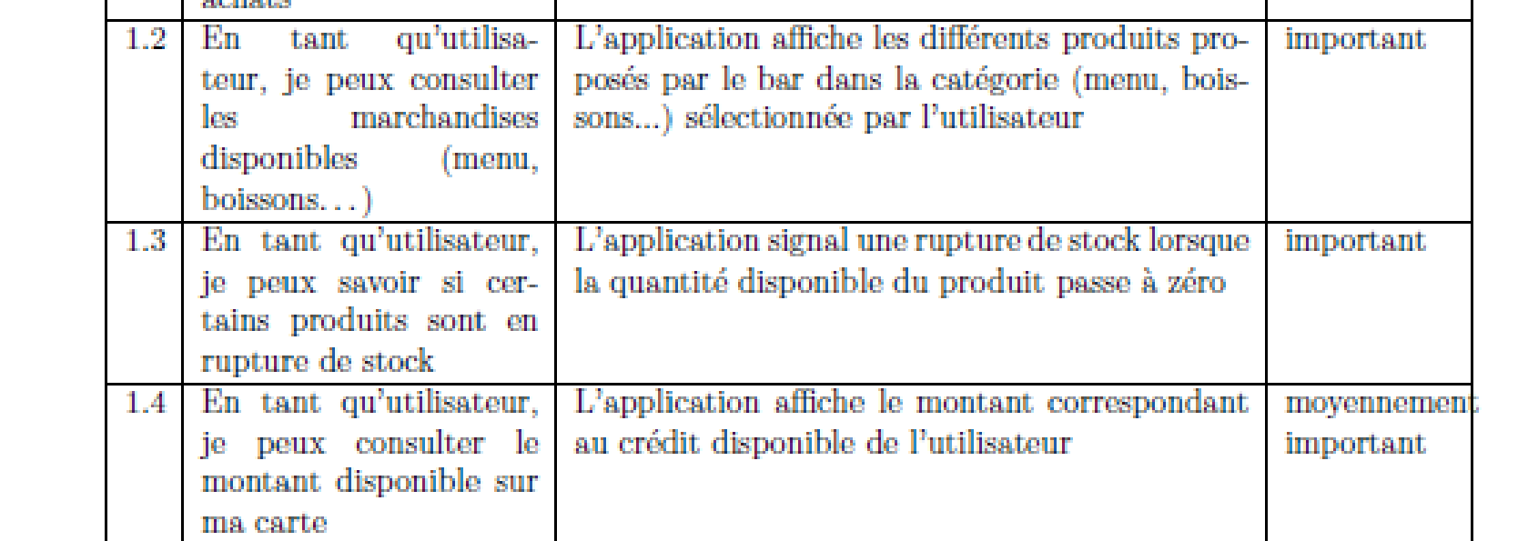
User requirement examples from 2A 2017 (Gestion du bar)
User Requirements

Slide 9
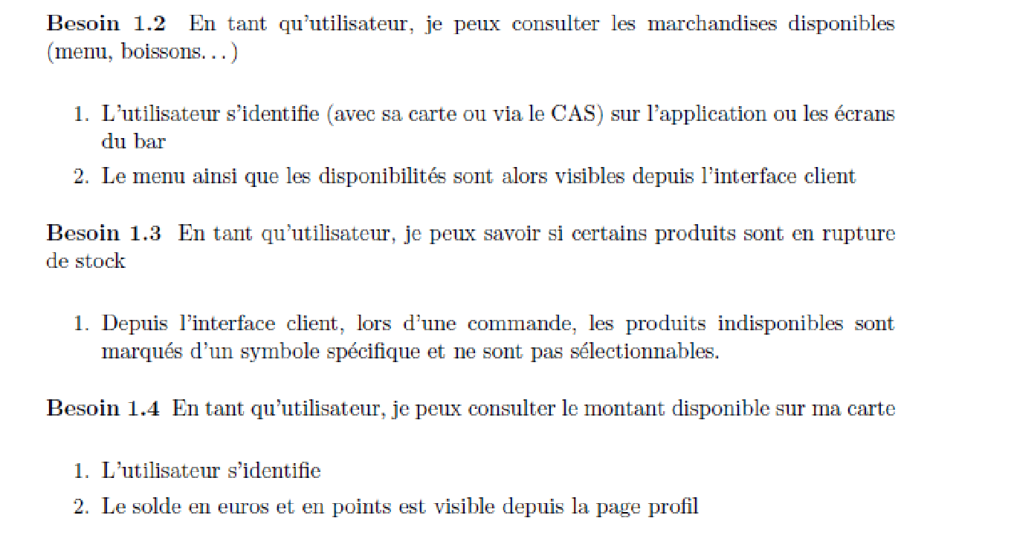
Example from 2A 2017 (Gestion du bar)
Requirements

Slide 10
Properties of a requirement
Unambiguous
Verifiable
Clear
Correct
Understandable
Feasible
Independent
Atomic
Necessary
Implementation-free
Consistent
Non Redundant
Complete
Nez
https://www.informit.com/articles/article.aspx?p=1152528&seqNum=4

Slide 11
Unambiguous
Only one way to interpret the requirement
L’application doit permettre au client de modifier leur commande à tout moment
Que signifie modifier une commande
Que signifie à tout moment

Slide 12
Verifiable
It should be possible to test that a requirement is implemented correctly
Be careful to word that are difficult to test : efficient, simple, user-friendly, flexible, quickly
Le système doit permettre aux enseignants d’ajouter des absences de façon simple.

Slide 13
Clear (Simple, Précis, Concis)
Requirements must not containt unnecessary information
Le système doit permettre à la scolarité de saisir une justification apportée par un étudiant en fonction de la date d’absence et de l’ajouter aux justifications d’absence pour faire en sorte que l’absence de l’étudiant ne soit pas comptée et que cela ne nuise pas à sa scolarité.
Le système doit permettre à la scolarité de saisir une justification d’absence apportée par un étudiant

Slide 14
Correct
If a requirement contains facts, they must be true
Une TVA de 20% doit être ajoutée au montant de la facture

Slide 15
Understandable
Requirements must be grammatically correct and written in a consistent style
Le système doit permettre aux membres bar de faire des modications des comptes clients notamment changer un compte de categorie.
Il faut pouvoir choisir parmi de nombreux produits

Slide 16
Feasible
The requirement must be doable within the constraints of the project (time, money, resources)
Le système doit permettre l’authentification des utilisateurs par reconnaissance faciale

Slide 17
Independent
To understand the requirement, there should not be a need to know any other requirement:
Le système permet à un utilisateur d’ajouter un produit à la commande dans une quantité donnée
Le montant de la commande est calculé au fur et à mesure.

Slide 18
Atomic
The requirement should contain a single traceable element:
Le système permet au responsible du bar de gérer les stocks

Slide 19
Necessary
A requirement is unnecessary if
None of the stakeholders needs the requirement.
or
Removing the requirement will not affect the system.
Le système doit permettre à un client du bar d’envoyer des messages

Slide 20
Implementation-Free
Requirements should not contain unnecessary design and implementation information:
Le système doit stocker les informations dans un fichier csv

Slide 21
Consistent
There should not be any conflicts between the requirements. Conflicts may be direct or indirect. Direct conflicts occur when, in the same situation, different behavior is expected:
Le système doit permettre de changer sa commande à tout moment
Le système doit permettre au Barman de valider une commande. Une fois validée elle ne peut plus être modifiée

Slide 22
Non-Redundant
Each requirement should be expressed only once and should not overlap with another requirement:
Le système doit permettre au trésorier de changer les prix des produits
Le système permet au trésorier de mettre à jour le prix des produits lors de la reception de commandes

Slide 23
Complete
A requirement should be specified for all conditions that can occur:
Le système doit permettre aux responsables du bar de valider une
commande servie au fur et a mesure.

Slide 24
Stakeholders
Any person or organization who is affected by the system in some way and so who has a legitimate interest, direct or indirect
Stakeholder types
End users
System managers
System owners
External stakeholders

Slide 25
Functional vs non-functional requirements
Functional Requirements
Non-Functional Requirements
Domain requirements

Slide 26
Functional and non-functional requirements
Functional requirements
Statements of services the system should provide, how the system should react to particular inputs and how the system should behave in particular situations.
May state what the system should not do.
Non-functional requirements
Constraints on the services or functions offered by the system such as timing constraints, constraints on the development process, standards, etc.
Often apply to the system as a whole rather than individual features or services.
Domain requirements
Constraints on the system from the domain of operation

Slide 27
Functional requirements
Describe functionality or system services.
Depend on the type of software, expected users and the type of system where the software is used.
Functional user requirements may be high-level statements of what the system should do.
Functional system requirements should describe the system services in detail.

Slide 28
Non-functional requirements
These define system properties and constraints e.g. reliability, response time and storage requirements. Constraints are I/O device capability, system representations, etc.
Process requirements may also be specified mandating a particular IDE, programming language or development method.
Non-functional requirements may be more critical than functional requirements. If these are not met, the system may be useless.

Slide 29
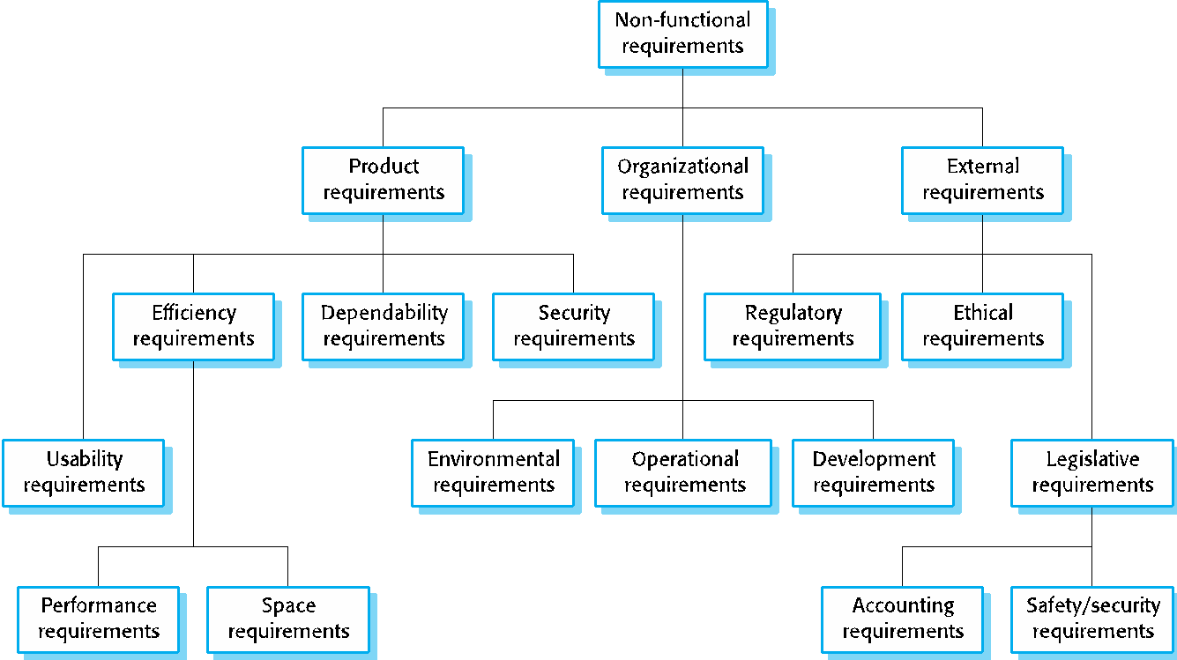
Types of nonfunctional requirement

Slide 30
Non-functional requirements implementation
Non-functional requirements may affect the overall architecture of a system rather than the individual components.
For example, to ensure that performance requirements are met, you may have to organize the system to minimize communications between components.
A single non-functional requirement, such as a security requirement, may generate a number of related functional requirements that define system services that are required.
It may also generate requirements that restrict existing requirements.

Slide 31
Non-functional classifications
Product requirements
Requirements which specify that the delivered product must behave in a particular way e.g. execution speed, reliability, etc.
Organisational requirements
Requirements which are a consequence of organisational policies and procedures e.g. process standards used, implementation requirements, etc.
External requirements
Requirements which arise from factors which are external to the system and its development process e.g. interoperability requirements, legislative requirements, etc.

Slide 32
Goals and requirements
Non-functional requirements may be very difficult to state precisely and imprecise requirements may be difficult to verify.
Goal
A general intention of the user such as ease of use.
Verifiable non-functional requirement
A statement using some measure that can be objectively tested.
Goals are helpful to developers as they convey the intentions of the system users.

Slide 33
Usability requirements
The system should be easy to use by medical staff and should be organized in such a way that user errors are minimized. (Goal)
Medical staff shall be able to use all the system functions after four hours of training. After this training, the average number of errors made by experienced users shall not exceed two per hour of system use. (Testable non-functional requirement)

Slide 34
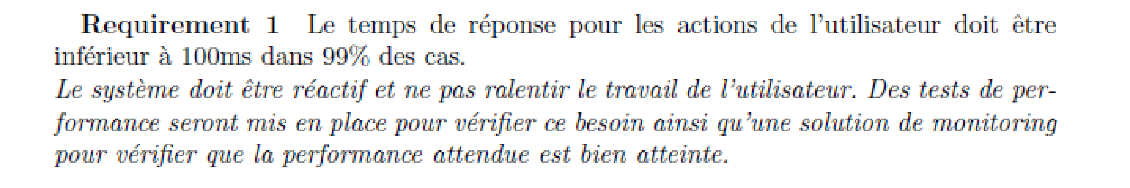
Performance requirement

Slide 35
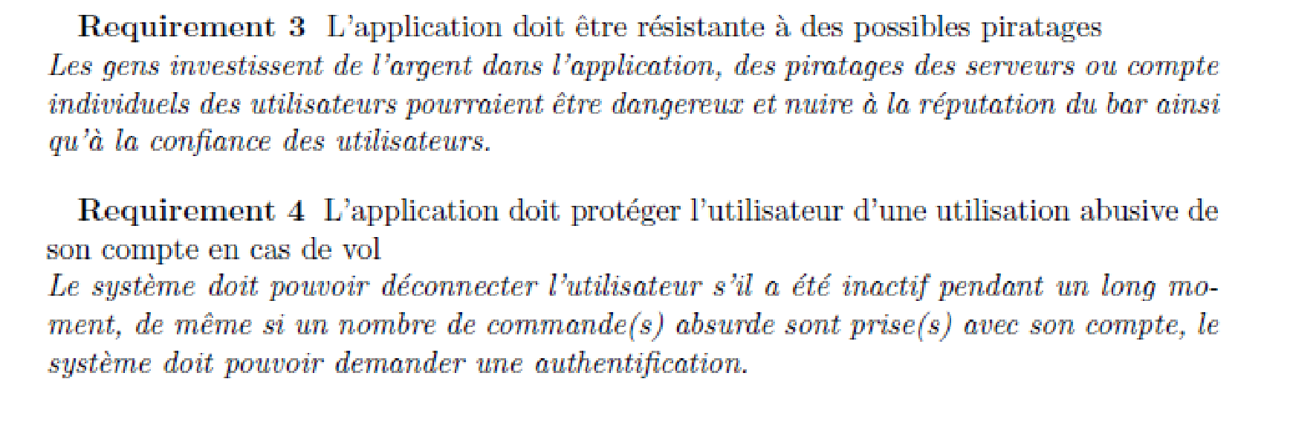
Non functional requirements

Slide 36
Requirements engineering processes

Slide 37
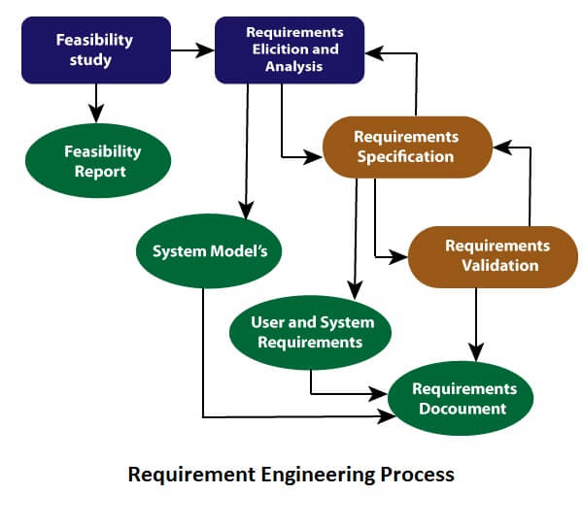
Requirement Engineering process
Process of defining, documenting and Maintaining requirements
Generic activities
Requirements elicitation;
Requirements analysis;
Requirement Specification
Requirements validation;
Requirements management
https://www.javatpoint.com/software-engineering-requirement-engineering

Slide 38
Requirements engineering processes
The processes used for RE vary widely depending on the application domain, the people involved and the organisation developing the requirements.
However, there are a number of generic activities common to all processes
Requirements elicitation;
Requirements analysis;
Requirements validation;
Requirements management.
In practice, RE is an iterative activity in which these processes are interleaved.

Slide 39
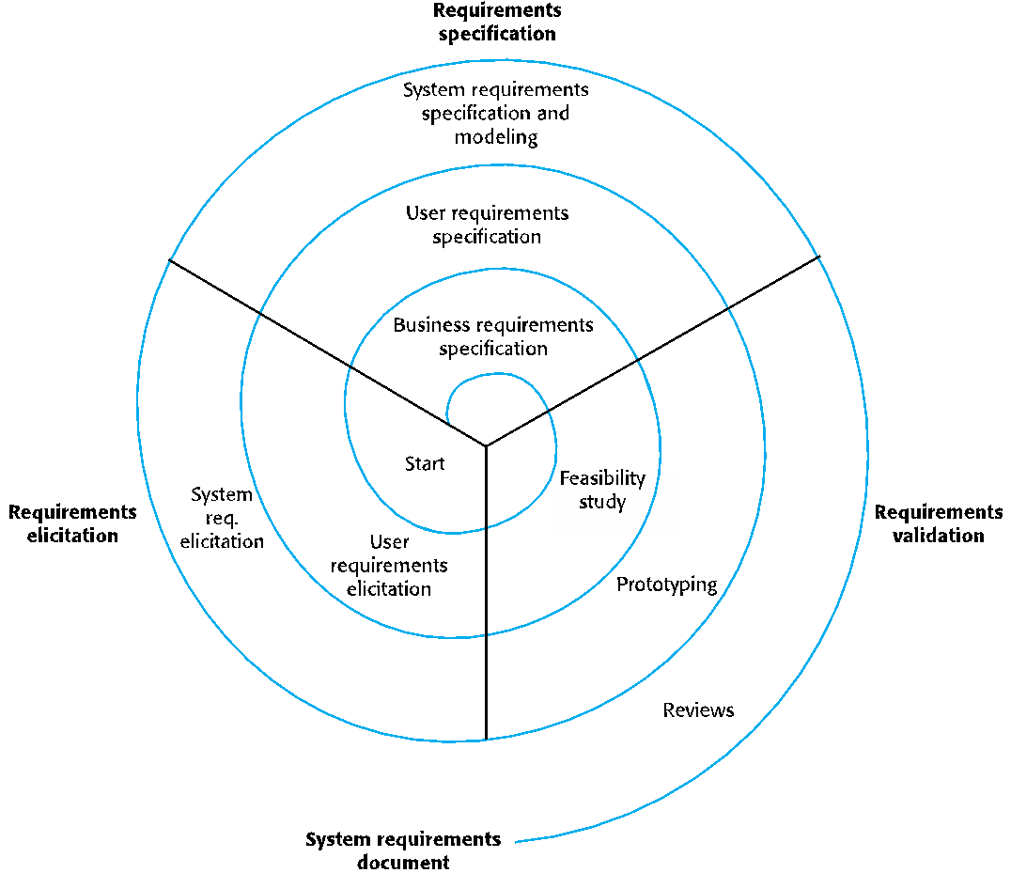
A spiral view of the requirements engineering process

Slide 40
Requirements elicitation and analysis
Sometimes called requirements elicitation or requirements discovery.
Involves technical staff working with customers to find out about the application domain, the services that the system should provide and the system’s operational constraints.
May involve end-users, managers, engineers involved in maintenance, domain experts, trade unions, etc. These are called stakeholders.

Slide 41
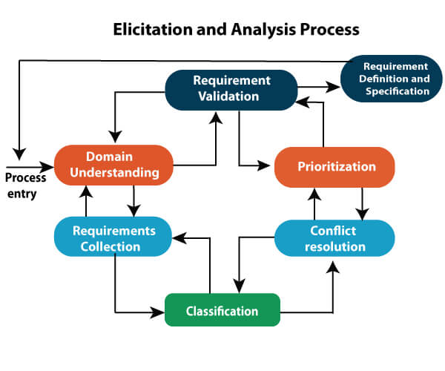
Requirements elicitation
Software engineers work with a range of system stakeholders to find out about the application domain, the services that the system should provide, the required system performance, hardware constraints, other systems, etc.
Stages include:
Requirements discovery,
Requirements classification and organization,
Requirements prioritization and negotiation,
Requirements specification.

Slide 42
Problems of requirements elicitation
Stakeholders don’t know what they really want.
Stakeholders express requirements in their own terms.
Different stakeholders may have conflicting requirements.
Organisational and political factors may influence the system requirements.
The requirements change during the analysis process. New stakeholders may emerge and the business environment may change.

Slide 43
Process activities
Requirements discovery
Interacting with stakeholders to discover their requirements. Domain requirements are also discovered at this stage.
Requirements classification and organisation
Groups related requirements and organises them into coherent clusters.
Prioritisation and negotiation
Prioritising requirements and resolving requirements conflicts.
Requirements specification
Requirements are documented and input into the next round of the spiral.

Slide 44
Requirements discovery
The process of gathering information about the required and existing systems and distilling the user and system requirements from this information.
Interaction is with system stakeholders from managers to external regulators.
Systems normally have a range of stakeholders.

Slide 45
Interviewing
Formal or informal interviews with stakeholders are part of most RE processes.
Types of interview
Closed interviews based on pre-determined list of questions
Open interviews where various issues are explored with stakeholders.
Effective interviewing
Be open-minded, avoid pre-conceived ideas about the requirements and are willing to listen to stakeholders.
Prompt the interviewee to get discussions going using a springboard question, a requirements proposal, or by working together on a prototype system.

Slide 46
Problems with interviews
Application specialists may use language to describe their work that isn’t easy for the requirements engineer to understand.
Interviews are not good for understanding domain requirements
Requirements engineers cannot understand specific domain terminology;
Some domain knowledge is so familiar that people find it hard to articulate or think that it isn’t worth articulating.

Slide 47
Ethnography
A social scientist spends a considerable time observing and analysing how people actually work.
People do not have to explain or articulate their work.
Social and organisational factors of importance may be observed.
Ethnographic studies have shown that work is usually richer and more complex than suggested by simple system models.

Slide 48
Scope of ethnography
Requirements that are derived from the way that people actually work rather than the way I which process definitions suggest that they ought to work.
Requirements that are derived from cooperation and awareness of other people’s activities.
Awareness of what other people are doing leads to changes in the ways in which we do things.
Ethnography is effective for understanding existing processes but cannot identify new features that should be added to a system.

Slide 49
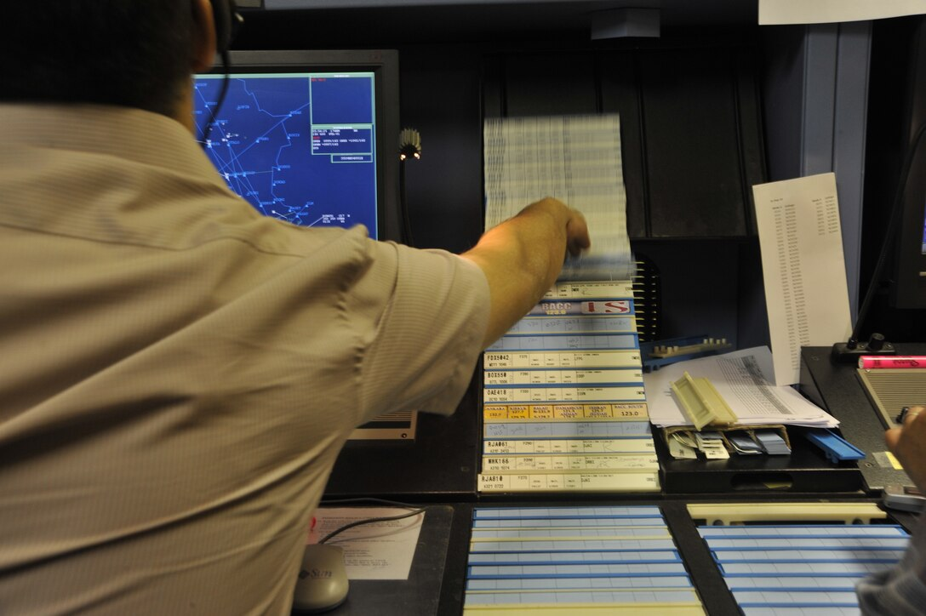
Focused ethnography
Developed in a project studying the air traffic control process
Combines ethnography with prototyping
Prototype development results in unanswered questions which focus the ethnographic analysis.
The problem with ethnography is that it studies existing practices which may have some historical basis which is no longer relevant.

Slide 50
Stories and scenarios
Scenarios and user stories are real-life examples of how a system can be used.
Stories and scenarios are a description of how a system may be used for a particular task.
Because they are based on a practical situation, stakeholders can relate to them and can comment on their situation with respect to the story.

Slide 51
Examples
As a teacher, I need to be able to point students that are not attending my lecture so that I can keep track of absentees.
As a study director, I need to be notified when a student is missing too many lectures
Stories can lead to the development of features

Slide 52
Requirements specification

Slide 53
Requirements specification
The process of writing down the user and system requirements in a requirements document.
Requirements have to be understandable by end-users and customers who do not have a technical background and by developers that need to build the system.
The requirements may be part of a contract for the system development
It is therefore important that these are as complete as possible.

Slide 54
Ways of writing a system requirements specification
Notation | Description
Natural language | The requirements are written using numbered sentences in natural language. Each sentence should express one requirement.
Structured natural language | The requirements are written in natural language on a standard form or template. Each field provides information about an aspect of the requirement.
Design description languages | This approach uses a language like a programming language, but with more abstract features to specify the requirements by defining an operational model of the system. This approach is now rarely used although it can be useful for interface specifications.
Graphical notations | Graphical models, supplemented by text annotations, are used to define the functional requirements for the system; UML use case and sequence diagrams are commonly used.
Mathematical specifications | These notations are based on mathematical concepts such as finite-state machines or sets. Although these unambiguous specifications can reduce the ambiguity in a requirements document, most customers don’t understand a formal specification. They cannot check that it represents what they want and are reluctant to accept it as a system contract

Slide 55
Natural language specification
Requirements are written as natural language sentences supplemented by diagrams and tables.
Used for writing requirements because it is expressive, intuitive and universal. This means that the requirements can be understood by users and customers.

Slide 56
Guidelines for writing requirements
Invent a standard format and use it for all requirements.
Use language in a consistent way. Use shall for mandatory requirements, should for desirable requirements.
Use text highlighting to identify key parts of the requirement.
Avoid the use of computer jargon.
Include an explanation (rationale) of why a requirement is necessary.

Slide 57
Problems with natural language
Lack of clarity
Precision is difficult without making the document difficult to read.
Requirements confusion
Functional and non-functional requirements tend to be mixed-up.
Requirements amalgamation
Several different requirements may be expressed together.

Slide 58
Structured specifications
An approach to writing requirements where the freedom of the requirements writer is limited and requirements are written in a standard way.
This works well for some types of requirements e.g. requirements for embedded control system but is sometimes too rigid for writing business system requirements.

Slide 59
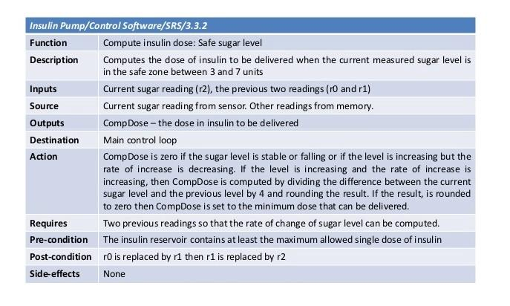
Form-based specifications
Definition of the function or entity.
Description of inputs and where they come from.
Description of outputs and where they go to.
Information about the information needed for the computation and other entities used.
Description of the action to be taken.
Pre and post conditions (if appropriate).
The side effects (if any) of the function.

Slide 60
Tabular specification
Used to supplement natural language.
Particularly useful when you have to define a number of possible alternative courses of action.
For example, the insulin pump systems bases its computations on the rate of change of blood sugar level and the tabular specification explains how to calculate the insulin requirement for different scenarios.

Slide 61
Tabular specification of computation for an insulin pump
Condition | Action
Sugar level falling (r2 < r1) | CompDose = 0
Sugar level stable (r2 = r1) | CompDose = 0
Sugar level increasing and rate of increase decreasing ((r2 – r1) < (r1 – r0)) | CompDose = 0
Sugar level increasing and rate of increase stable or increasing ((r2 – r1) ≥ (r1 – r0)) | CompDose = round ((r2 – r1)/4) If rounded result = 0 then CompDose = MinimumDose

Slide 62
The software requirements document
The software requirements document is the official statement of what is required of the system developers.
Should include both a definition of user requirements and a specification of the system requirements.
It is NOT a design document. As far as possible, it should set of WHAT the system should do rather than HOW it should do it.

Slide 63
Requirements document variability
Information in requirements document depends on type of system and the approach to development used.
Systems developed incrementally will, typically, have less detail in the requirements document.
Requirements documents standards have been designed e.g. IEEE standard. These are mostly applicable to the requirements for large systems engineering projects.

Slide 64
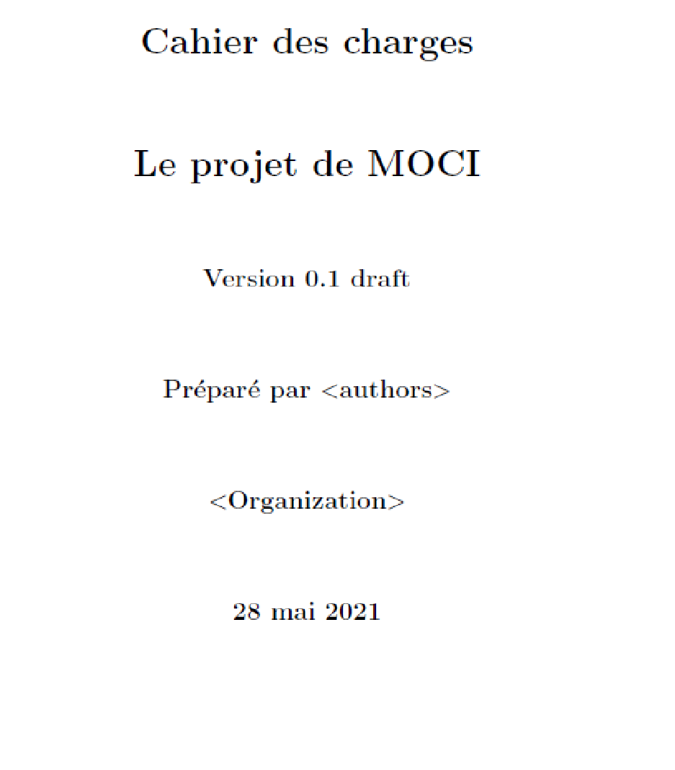
Un modèle de document (celui du projet)

Slide 65
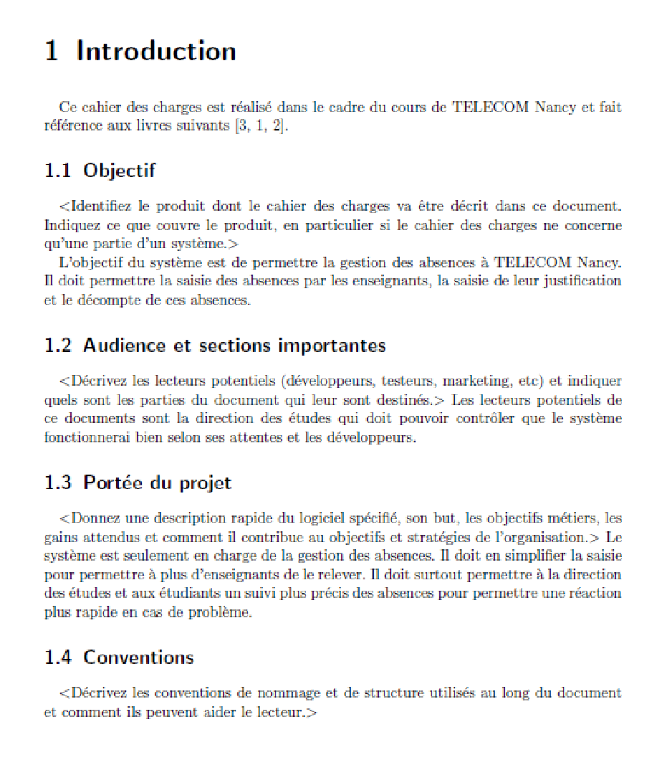
Introduction

Slide 66
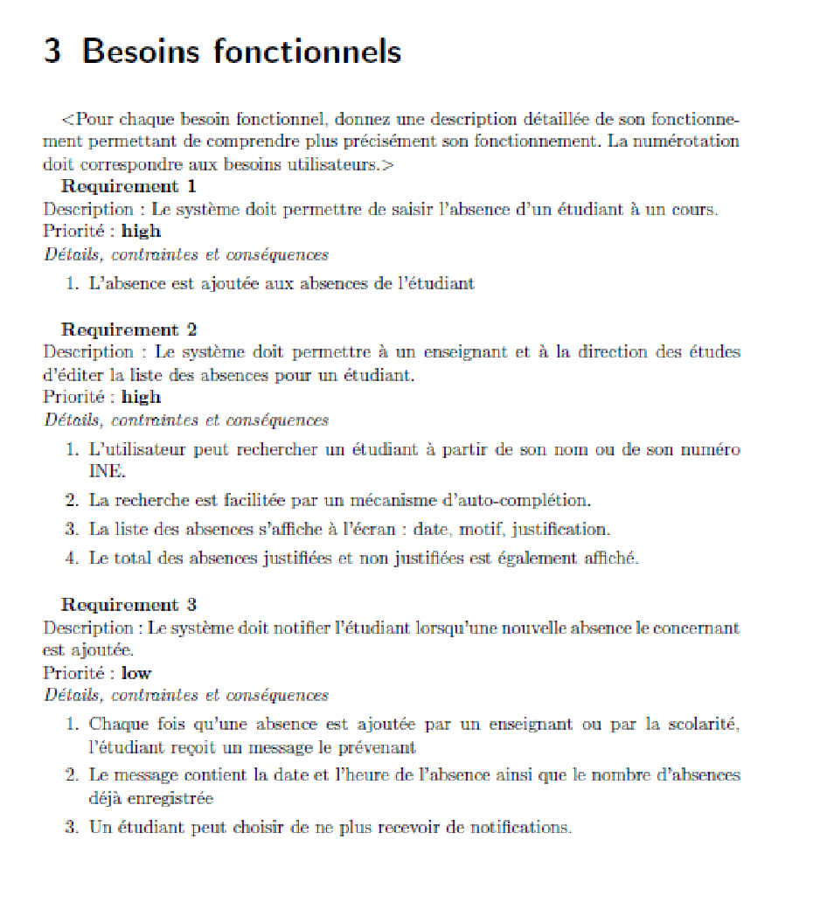
Besoins fonctionnels

Slide 67
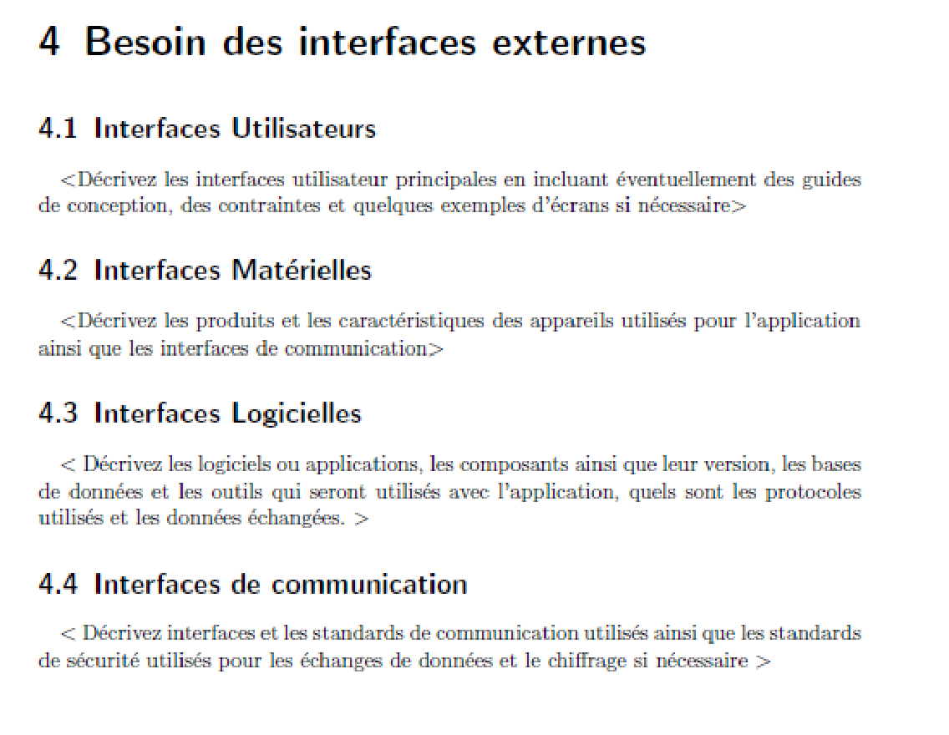
Besoins des interfaces externes

Slide 68
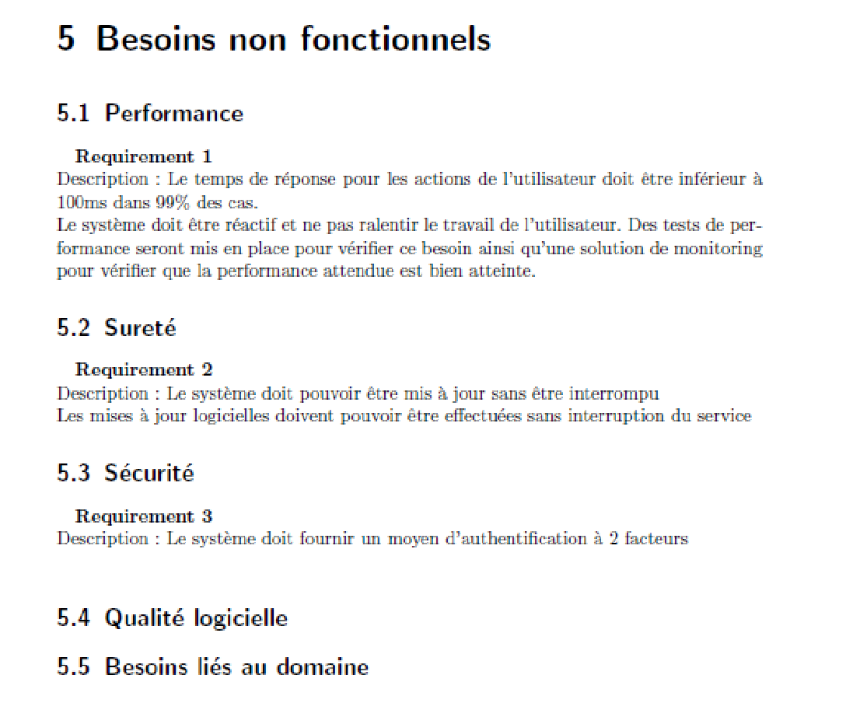
Besoins non fonctionnels

Slide 69
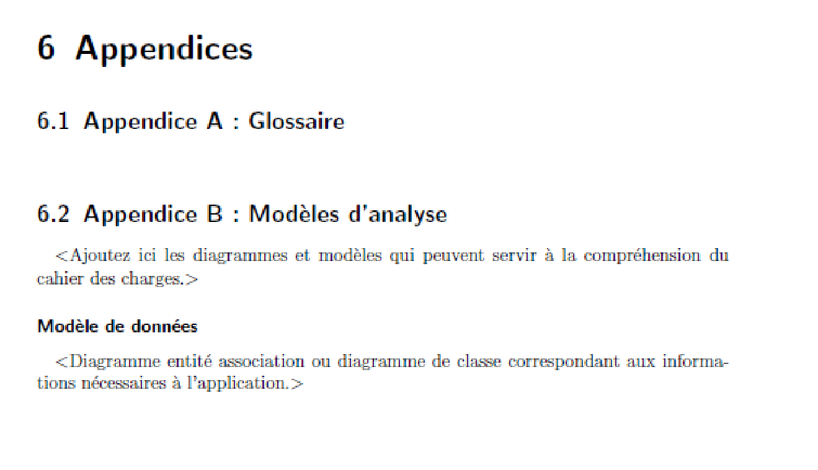
Appendices

Slide 70
Requirements validation

Slide 71
Requirements validation
Concerned with demonstrating that the requirements define the system that the customer really wants.
Requirements error costs are high so validation is very important
Fixing a requirements error after delivery may cost up to 100 times the cost of fixing an implementation error.

Slide 72
Requirements checking
Validity. Does the system provide the functions which best support the customer’s needs?
Consistency. Are there any requirements conflicts?
Completeness. Are all functions required by the customer included?
Realism. Can the requirements be implemented given available budget and technology
Verifiability. Can the requirements be checked?

Slide 73
Requirements validation techniques
Requirements reviews
Systematic manual analysis of the requirements.
Prototyping
Using an executable model of the system to check requirements. Covered in Chapter 2.
Test-case generation
Developing tests for requirements to check testability.

Slide 74
Requirements reviews
Regular reviews should be held while the requirements definition is being formulated.
Both client and contractor staff should be involved in reviews.
Reviews may be formal (with completed documents) or informal. Good communications between developers, customers and users can resolve problems at an early stage.

Slide 75
Review checks
Verifiability
Is the requirement realistically testable?
Comprehensibility
Is the requirement properly understood?
Traceability
Is the origin of the requirement clearly stated?
Adaptability
Can the requirement be changed without a large impact on other requirements?

Slide 76
Requirements management
Requirements management is the process of managing changing requirements during the requirements engineering process and system development.
New requirements emerge as a system is being developed and after it has gone into use.
You need to keep track of individual requirements and maintain links between dependent requirements so that you can assess the impact of requirements changes. You need to establish a formal process for making change proposals and linking these to system requirements.

Slide 77
Key points
Requirements for a software system set out what the system should do and define constraints on its operation and implementation.
Functional requirements are statements of the services that the system must provide or are descriptions of how some computations must be carried out.
Non-functional requirements often constrain the system being developed and the development process being used.
They often relate to the emergent properties of the system and therefore apply to the system as a whole.

Slide 78
Key points
The requirements engineering process is an iterative process that includes requirements elicitation, specification and validation.
Requirements elicitation is an iterative process that can be represented as a spiral of activities – requirements discovery, requirements classification and organization, requirements negotiation and requirements documentation.
You can use a range of techniques for requirements elicitation including interviews and ethnography. User stories and scenarios may be used to facilitate discussions.

Slide 79
Key points
Requirements specification is the process of formally documenting the user and system requirements and creating a software requirements document.
The software requirements document is an agreed statement of the system requirements. It should be organized so that both system customers and software developers can use it.

Slide 80
Key points
Requirements validation is the process of checking the requirements for validity, consistency, completeness, realism and verifiability.
Business, organizational and technical changes inevitably lead to changes to the requirements for a software system. Requirements management is the process of managing and controlling these changes.

Slide 81
Requirements and Software Products

Slide 82
Software products
Software products are generic software systems that provide functionality that is useful to a range of customers.
Many different types of products are available from large-scale business systems (e.g. MS Excel) through personal products (e.g. Evernote) to simple mobile phone apps and games (e.g. Suduko).
Software product engineering methods and techniques have evolved from software engineering techniques that support the development of one-off, custom software systems.
Custom software systems are still important for large businesses, government and public bodies. They are developed in dedicated software projects.

Slide 83
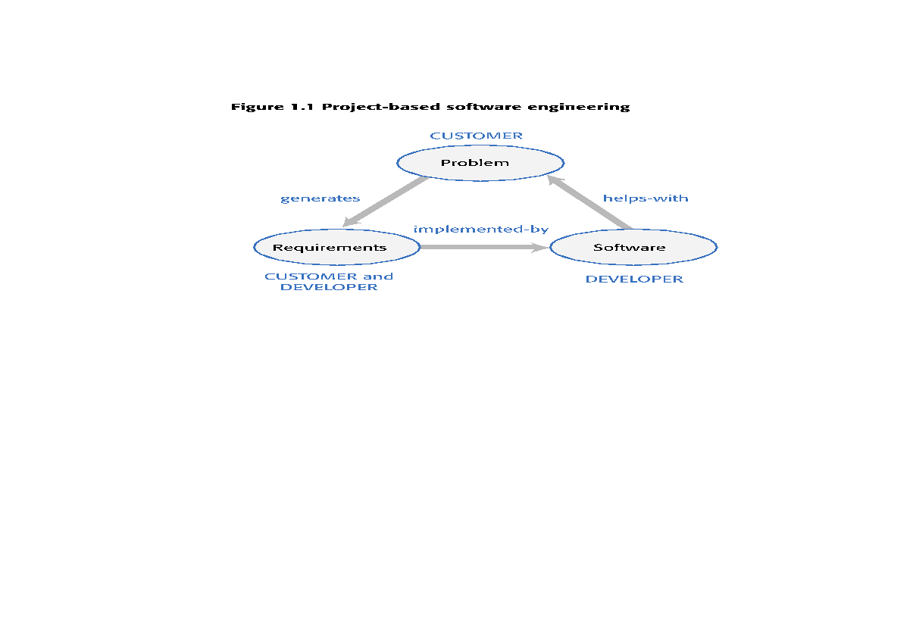
Figure 1.1 Project-based software engineering

Slide 84
Product software engineering
The starting point for product development is a business opportunity that is identified by individuals or a company. They develop a software product to take advantage of this opportunity and sell this to customers.
The company who identified the opportunity design and implement a set of software features that realize the opportunity and that will be useful to customers.
The software development company are responsible for deciding on the development timescale, what features to include and when the product should change.
Rapid delivery of software products is essential to capture the market for that type of product.

Slide 85
Table 1.1 Software product lines and platforms
Software product line A set of software products that share a common core. Each member of the product line includes customer-specific adaptations and additions. Software product lines may be used to implement a custom system for a customer with specific needs that can’t be met by a generic product.
Platform A software (or software+hardware) product that includes functionality so that new applications can be built on it. An example of a platform that you probably use is Facebook. It provides an extensive set of product functionality but also provides support for creating ‘Facebook apps’. These add new features that may be used by a business or a Facebook interest group.

Slide 86
Software execution models
Stand-alone The software executes entirely on the customer’s computers.
Hybrid Part of the software’s functionality is implemented on the customer’s computer but some features are implemented on the product developer’s servers.
Software service All of the product’s features are implemented on the developer’s servers and the customer accesses these through a browser or a mobile app.

Slide 87
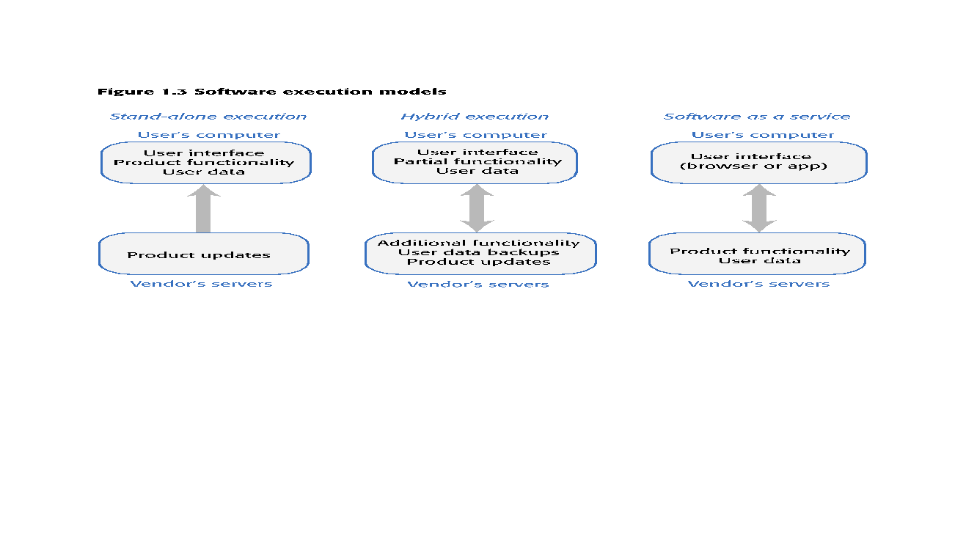
Figure 1.3 Software execution models

Slide 88
Comparable software development
The key feature of product development is that there is no external customer that generates requirements and pays for the software. This is also true for other types of software development:
Student projects Individuals or student groups develop software as part of their course. Given an assignment, they decide what features to include in the software.
Research software Researchers develop software to help them answer questions that are relevant to their research.
Internal tool development Software developers may develop tools to support their work - in essence, these are internal products that are not intended for customer release.

Slide 89
Features, scenarios and stories

Slide 90
Software products
There are three factors that drive the design of software products
Business and consumer needs that are not met by current products
Dissatisfaction with existing business or consumer software products
Changes in technology that make completely new types of product possible
In the early stage of product development, you are trying to understand, what product features would be useful to users, and what they like and dislike about the products that they use.

Slide 91
Software features
A feature is a fragment of functionality such as a ‘print’ feature, a ‘change background feature’, a ‘new document’ feature and so on.
Before you start programming a product, you should aim to create a list of features to be included in your product.
The feature list should be your starting point for product design and development.

Slide 92
User understanding
It makes sense in any product development to spend time trying to understand the potential users and customers of your product.
A range of techniques have been developed for understanding the ways that people work and use software.
These include user interviews, surveys, ethnography and task analysis.
Some of these techniques are expensive and unrealistic for small companies.
Informal user analysis and discussions, which simply involve asking users about their work, the software that they use, and its strengths and weaknesses are inexpensive and very valuable.

Slide 93
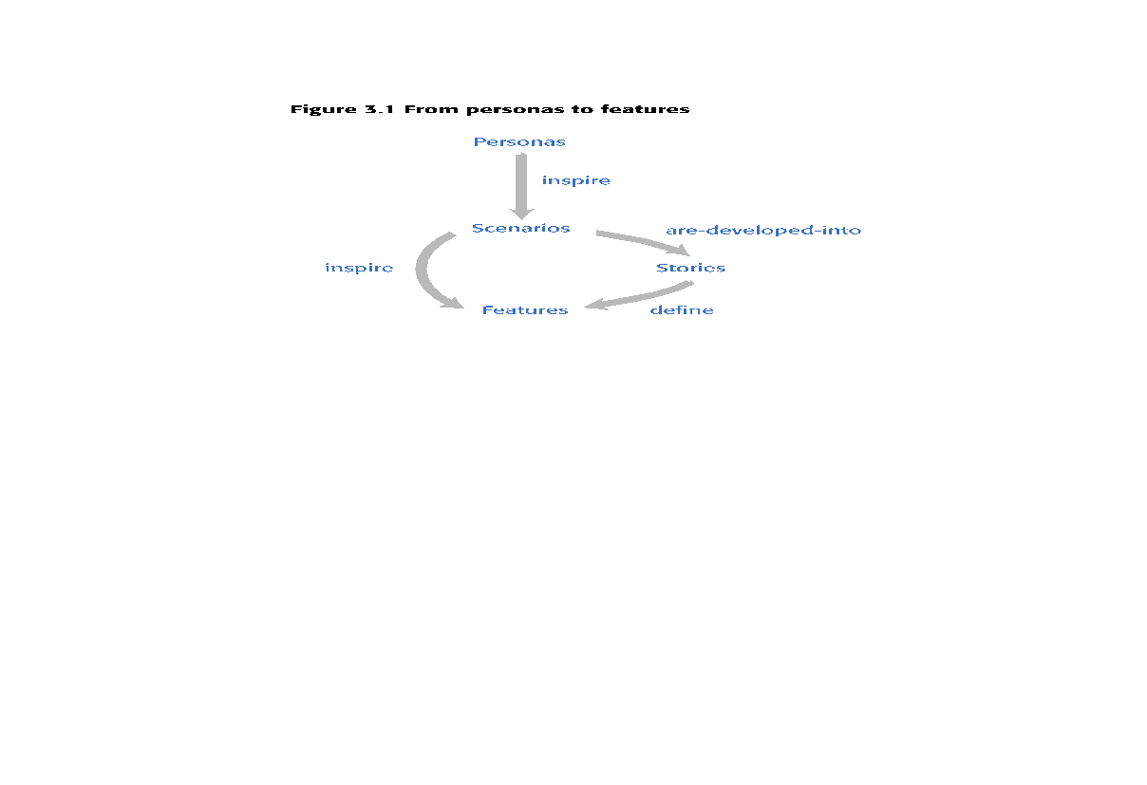
Figure 3.1 From personas to features
A way of representing users
Natural language descriptions of a user interacting with a software product
Natural language descriptions of something that is needed or wanted by users
Fragments of product functionality

Slide 94
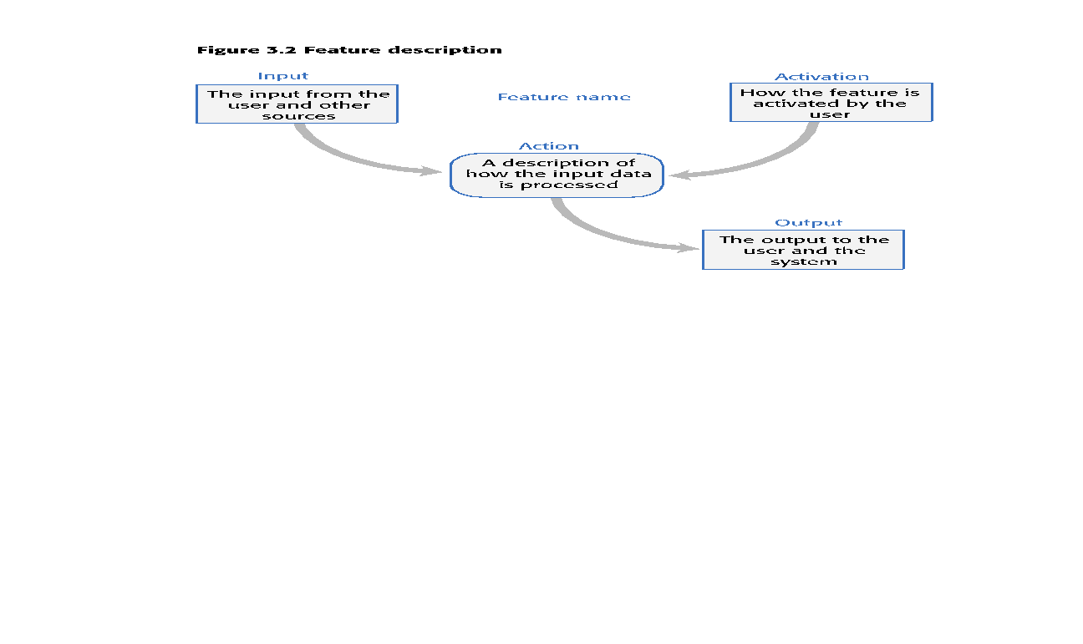
Figure 3.2 Feature description

Slide 95
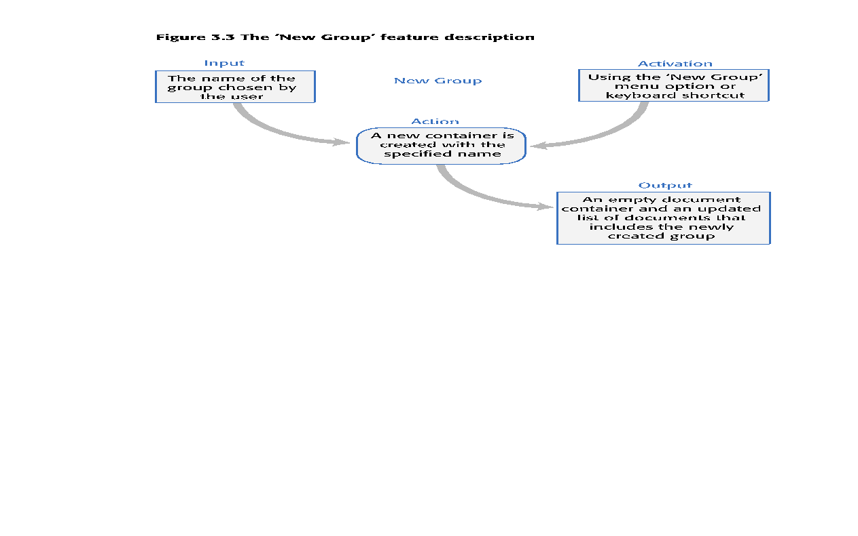
Figure 3.3 The ‘New Group’ feature description

Slide 96
Personas
You need to have an understanding of your potential users to design features that they are likely to find useful and to design a user interface that is suited to them.
Personas are ‘imagined users’ where you create a character portrait of a type of user that you think might use your product.
For example, if your product is aimed at managing appointments for dentists, you might create a dentist persona, a receptionist persona and a patient persona.
Personas of different types of user help you imagine what these users may want to do with your software and how it might be used. They help you envisage difficulties that they might have in understanding and using product features.

Slide 97
Table 3.1 A persona for a primary school teacher
Jack, a primary school teacher
Jack, age 32, is a primary school (elementary school) teacher in Ullapool, a large coastal village in the Scottish Highlands. He teaches children from ages 9-12. He was born in a fishing community north of Ullapool, where his father runs a marine fuels supply business and his mother is a community nurse. He has a degree in English from Glasgow University and retrained as a teacher after several years working as a web content author for a large leisure group.
Jack’s experience as a web developer means that he is confident in all aspects of digital technology. He passionately believes that the effective use of digital technologies, blended with face to face teaching, can enhance the learning experience for children. He is particularly interested in using the iLearn system for project-based teaching, where students work together across subject areas on a challenging topic.

Slide 98
Persona descriptions
A persona should ‘paint a picture’ of a type of product user. They should be relatively short and easy-to-read.
You should describe their background and why they might want to use your product.
You should also say something about their educational background and technical skills.
These help you assess whether or not a software feature is likely to be useful, understandable and usable by typical product users.

Slide 99
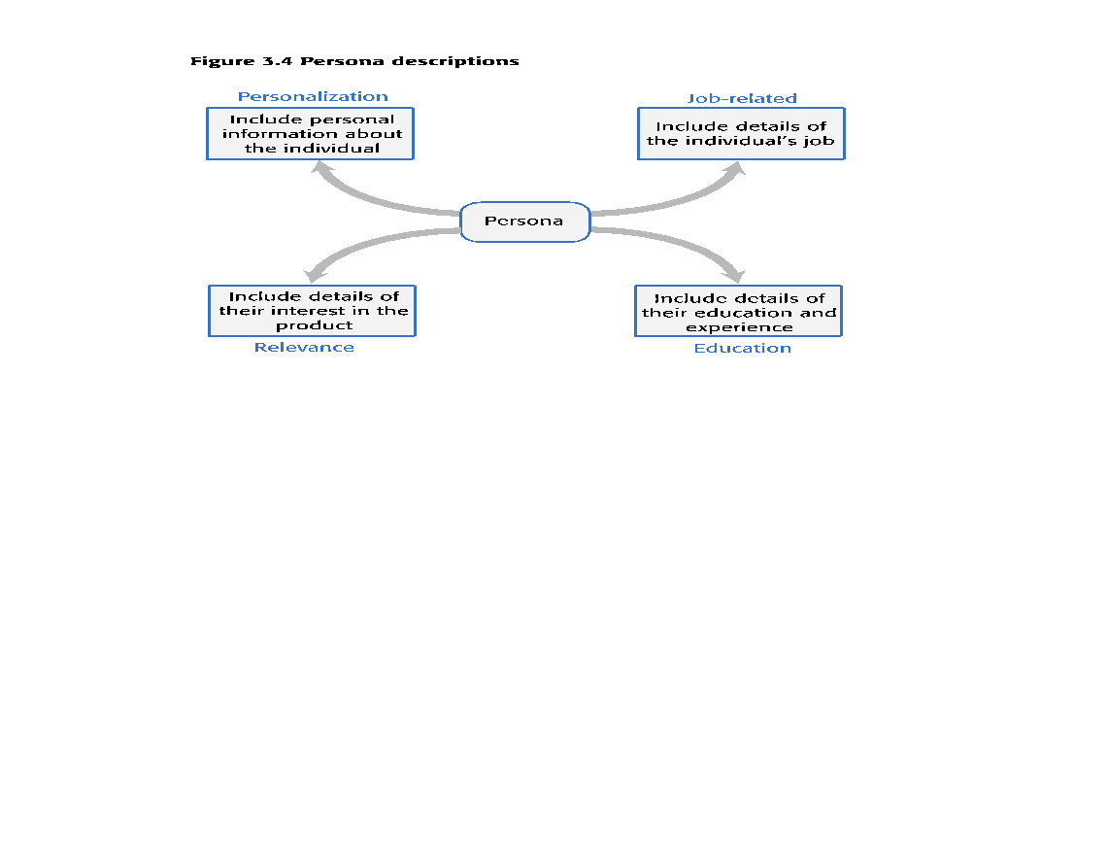
Figure 3.4 Persona descriptions

Slide 100
Table 3.2 Aspects of a persona description
Personalization
You should give them a name and say something about their personal circumstances. This is important because you shouldn’t think of a persona as a role but as an individual. It is sometimes helpful to use an appropriate stock photograph to represent the person in the persona. Some studies suggest that this helps project teams use personas more effectively.
Job-related If your product is targeted at business, you should say something about their job and (if necessary) what that job involves. For some jobs, such as a teacher where readers are likely to be familiar with the job, this may not be necessary.
Education You should describe their educational background and their level of technical skills and experience. This is important, especially for interface design.
Relevance If you can, you should say why they might be interested in using the product and what they might want to do with it.

Slide 101
Table 3.3 A persona for a history teacher
Emma, a history teacher Emma, age 41, is a history teacher in a secondary school (high school) in Edinburgh. She teaches students from ages 12 to 18. She was born in Cardiff in Wales where both her father and her mother were teachers. After completing a degree in history from Newcastle University, she moved to Edinburgh to be with her partner and trained as a teacher. She has two children, aged 6 and 8, who both attend the local primary school. She likes to get home as early as she can to see her children, so often does lesson preparation, administration and marking from home.
Emma uses social media and the usual productivity applications to prepare her lessons, but is not particularly interested in digital technologies. She hates the virtual learning environment that is currently used in her school and avoids using it if she can. She believes that face-to-face teaching is most effective. She might use the iLearn system for administration and access to historic films and documents. However, she is not interested in a blended digital/face-to-face approach to teaching.

Slide 102
Table 3.4 A persona for an IT technician
Elena, a school IT technician Elena, age 28, is a senior IT technician in a large secondary school (high school) in Glasgow with over 2000 students. Originally from Poland, she has a diploma in electronics from Potsdam University. She moved to Scotland in 2011 after being unemployed for a year after graduation. She has a Scottish partner, no children, and hopes to develop her career in Scotland. She was originally appointed as a junior technician but was promoted, in 2014, to a senior post responsible for all the school computers.
Although not involved directly in teaching, Elena is often called on to help in computer science classes. She is a competent Python programmer and is a ‘power user’ of digital technologies. She has a long-term career goal of becoming a technical expert in digital learning technologies and being involved in their development. She wants to become an expert in the iLearn system and sees it as an experimental platform for supporting new uses for digital learning.

Slide 103
Persona benefits
The main benefit of personas is that they help you and other development team members empathize with potential users of the software.
Personas help because they are a tool that allows developers to ‘step into the user’s shoes’.
Instead of thinking about what you would do in a particular situation, you can imagine how a persona would behave and react.
Personas can help you check your ideas to make sure that you are not including product features that aren’t really needed.
They help you to avoid making unwarranted assumptions, based on your own knowledge, and designing an over-complicated or irrelevant product.

Slide 104
Deriving personas
Personas should be based on an understanding of the potential product users, their jobs, their background and their aspirations.
You should study and survey potential users to understand what they want and how they might use the product.
From this data, you can then abstract the essential information about the different types of product user and use this as a basis for creating personas.
Personas that are developed on the basis of limited user information are called proto-personas.
Proto-personas may be created as a collective team exercise using whatever information is available about potential product users. They can never be as accurate as personas developed from detailed user studies, but they are better than nothing.

Slide 105
Scenarios
A scenario is a narrative that describes how a user, or a group of users, might use your system.
There is no need to include everything in a scenario – the scenario isn’t a system specification.
It is simply a description of a situation where a user is using your product’s features to do something that they want to do.
Scenario descriptions may vary in length from two to three paragraphs up to a page of text.

Slide 106
Table 3.5 Jack’s scenario:using the iLearn system for class projects
Fishing in Ullapool Jack is a primary school teacher in Ullapool, teaching P6 pupils. He has decided that a class project should be focused around the fishing industry in the area, looking at the history, development and economic impact of fishing.
As part of this, students are asked to gather and share reminiscences from relatives, use newspaper archives and collect old photographs related to fishing and fishing communities in the area. Pupils use an iLearn wiki to gather together fishing stories and SCRAN (a history archive site) to access newspaper archives and photographs. However, Jack also needs a photo-sharing site as he wants students to take and comment on each others’ photos and to upload scans of old photographs that they may have in their families. He needs to be able to moderate posts with photos before they are shared, because pre-teen children can’t understand copyright and privacy issues.
Jack sends an email to a primary school teachers’ group to see if anyone can recommend an appropriate system. Two teachers reply and both suggest that he uses KidsTakePics, a photo-sharing site that allows teachers to check and moderate content. As KidsTakePics is not integrated with the iLearn authentication service, he sets up a teacher and a class account with KidsTakePics.
He uses the the iLearn setup service to add KidsTakePics to the services seen by the students in his class so that, when they log in, they can immediately use the system to upload photos from their phones and class computers.

Slide 107
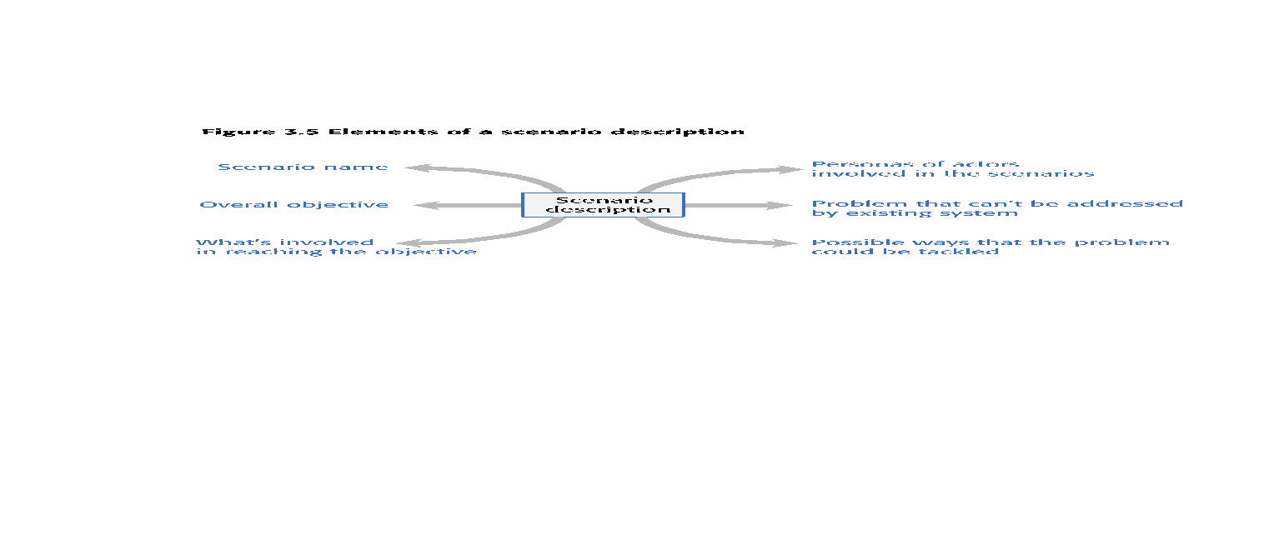
Figure 3.5 Elements of a scenario description

Slide 108
Scenario elements
A brief statement of the overall objective.
In Jack’s scenario, this is to support a class project on the fishing industry.
References to the personas involved (Jack) so that you can get information about the capabilities and motivation of that user.
Information about what is involved in doing the activity. For example, in Jack’s scenario this involves gathering reminiscences from relatives, accessing newspaper archives, etc.
An explanation of problems that can’t be readily addressed using the existing system.
Young children don’t understand issues such as copyright and privacy, so photo sharing requires a site that a teacher can moderate to make sure that published images are legal and acceptable.
A description of one way that the identified problem might be addressed.
In Jack’s scenario, the preferred approach is to use an external tool designed for school students.

Slide 109
Emma’s scenario
Emma’s scenario is different from Jack’s scenario in that it describes a common and well-understood process rather than something new.
Emma is an e-learning sceptic and she is not interested in innovative applications. She wants a system that will make her life easier and reduce the amount of routine administration that she has to do.
The scenario discusses how parts of the process (setting up an email group and web page) are automated by the iLearn system.

Slide 110
Table 3.6 Emma’s scenario: using iLearn for administration
Emma is teaching the history of the First World War to a class of 14 year olds (S3). A group of S3 students are visiting the historic World War One battlefields in northern France. She want to set up a ‘battlefields group’ where the students who are attending the trip can share their research about the places they are visiting as well as their pictures and thoughts about the visit.
From home, she logs onto the iLearn system system using her Google account credentials. Emma has two iLearn accounts – her teacher account and a parent account associated with the local primary school. The system recognises that she is a multiple account owner and asks her to select the account to be used. She chooses the teacher account and the system generates her personal welcome screen. As well as her selected applications, this also shows management apps that help teachers create and manage student groups.
Emma selects the ‘group management’ app, which recognizes her role and school from her identity information and creates a new group. The system prompts for the class year (S3) and subject (history) and automatically populates the new group with all S3 students who are studying history. She selects those students going on the trip and adds her teacher colleagues, Jamie and Claire, to the group.

Slide 111
Table 3.6 Emma’s scenario: using iLearn for administration
She names the group and confirms that it should be created. The app sets up an icon on her iLearn screen to represent the group, creates an email alias for the group and asks Emma if she wishes to share the group. She shares access with everyone in the group, which means that they also see the icon on their screen. To avoid getting too many emails from students, restricts sharing of the email alias to Jamie and Claire.
The group management app then asksEmma if she wishes to set up a group web page, wiki and blog. Emma confirms that a web page should be created and she types some text to be included on that page.
She then accesses flickr using the icon on her screen, logs in and creates a private group to share trip photos that students and teachers have taken. She uploads some of her own photos from previous trips and emails an invitation to join the photo-sharing group to the Battlefield email list. Emma uploads material from her own laptop that she has written about the trip to iLearn and shares this with the ‘Battlefields Group’. This action adds her documents to the web page and generates an alert to group members that new material is available.

Slide 112
Writing scenarios
Scenarios should always be written from the user’s perspective and based on identified personas or real users.
Your starting point for scenario writing should be the personas that you have created. You should normally try to imagine several scenarios from each persona.
Ideally, scenarios should be general and should not include implementation information.
However, describing an implementation is often the easiest way to explain how a task is done.
It is important to ensure that you have coverage of all of the potential user roles when describing a system.

Slide 113
Table 3.7 Elena’s scenario: configuring the iLearn system
Elena has been asked by David, the head of the art department in her school, to help set up an iLearn environment for his department. David wants an environment that includes tools for making and sharing art, access to external websites to study artworks, and ‘exhibition’ facilities so that the students’ work can be displayed.
Elena’s starts by talking to art teachers to discover the tools that they recommend and the art sites that they use for studies. She also discovers that the tools they use and the sites they access vary according to the age of their students. Consequently, different student groups should be presented with a toolset that is appropriate for their age and experience.
Once she has established what is required, Elena logs into the iLearn system as an administrator and starts configuring the art environment using the iLearn setup service. She creates sub-environments for three age groups plus a shared environment that includes tools and sites that may be used by all students.
She drags and drops tools that are available locally and the URLs of external websites into each of these environments. For each of the sub-environments, she assigns an art teacher as its administrator so that they can refine the tool and web site selection that has been set up. She publishes the environments in ‘review mode’ and makes them available to the teachers in the art department.
After discussing the environments with the teachers, Elena shows them how to refine and extend the environments. Once they have agreed that the art environment is useful, it is released to all students in the school.

Slide 114
User involvement
It is easy for anyone to read and understand scenarios, so it is possible to get users involved in their development.
The best approach is to develop an imaginary scenario based on our understanding of how the system might be used then ask users to explain what you have got wrong.
They might ask about things they did not understand and suggest how the scenario could be extended and made more realistic.
Our experience was that users are not good at writing scenarios.
The scenarios that they created were based on how they worked at the moment. They were far too detailed and the users couldn’t easily generalize their experience.

Slide 115
User stories
Scenarios are high-level stories of system use. They should describe a sequence of interactions with the system but should not include details of these interactions.
User stories are finer-grain narratives that set out in a more detailed and structured way a single thing that a user wants from a software system.
As an author, I need a way to organize the book that I’m writing into chapters and sections.
This story reflects what has become the standard format of a user story:
As a <role>, I <want | need> to <do something>
As a teacher, I want to tell all members of my group when new information is available
A variant of this standard format adds a justification for the action:
As a <role> I <want | need> to <do something> so that <reason>
As a teacher, I need to be able to report who is attending a class trip so that the school maintains the required health and safety records.

Slide 116
User stories in planning
An important use of user stories is in planning.
Many users of the Scrum method represent the product backlog as a set of user stories.
User stories should focus on a clearly defined system feature or aspect of a feature that can be implemented within a single sprint.
If the story is about a more complex feature that might take several sprints to implement, then it is called an epic.
As a system manager, I need a way to backup the system and restore either individual applications, files, directories or the whole system.
There is a lot of functionality associated with this user story. For implementation, it should be broken down into simpler stories with each story focusing on a single aspect of the backup system.

Slide 117
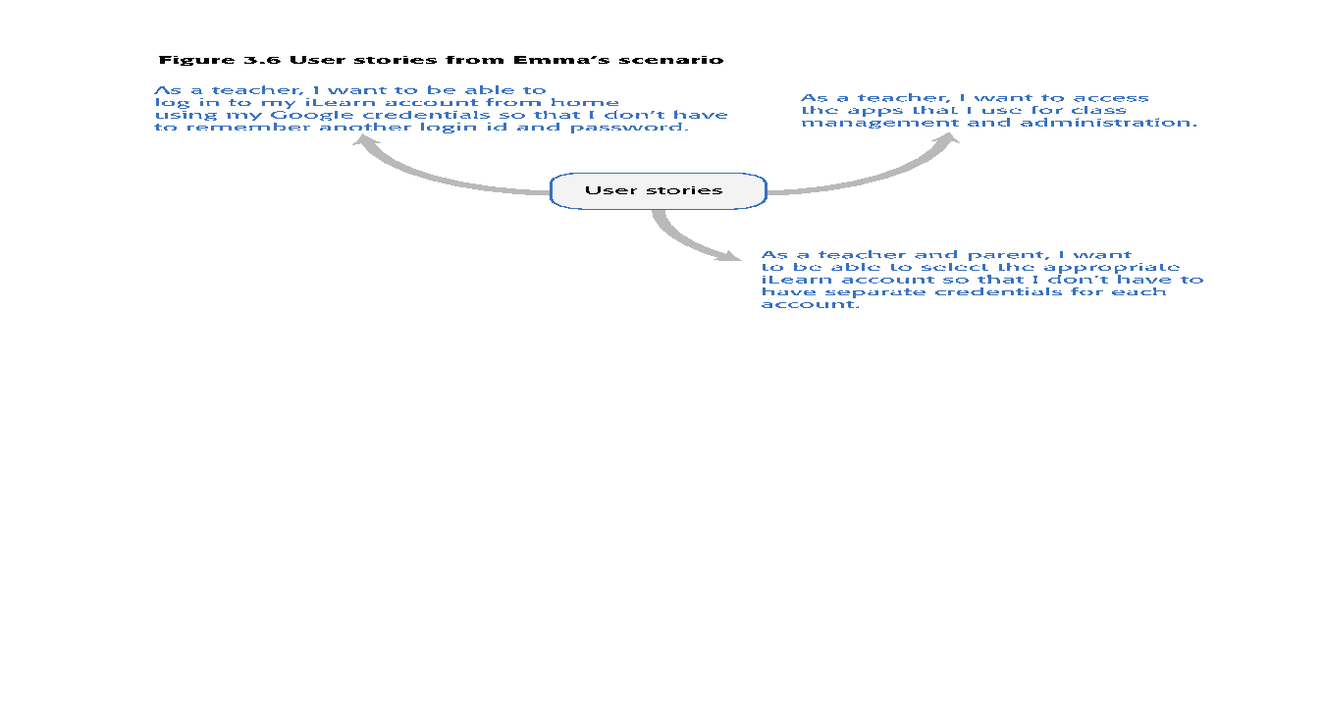
Figure 3.6 User stories from Emma’s scenario

Slide 118
Feature description using user stories
Stories can be used to describe features in your product that should be implemented.
Each feature can have a set of associated stories that describe how that feature is used.

Slide 119
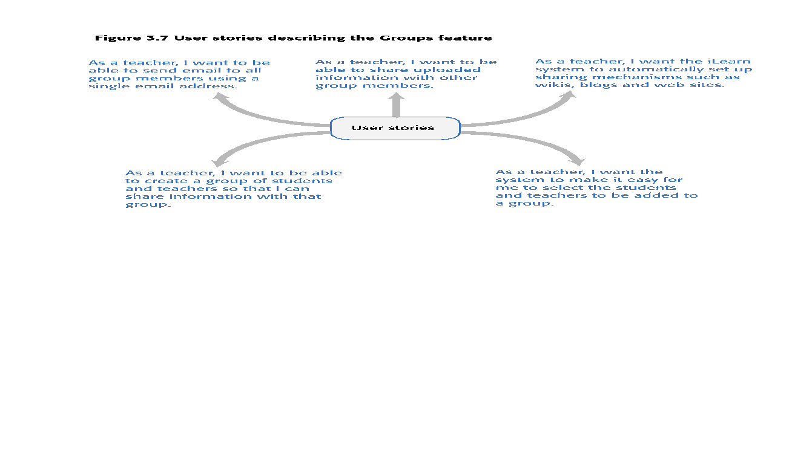
Figure 3.7 User stories describing the Groups feature

Slide 120
Stories and scenarios
As you can express all of the functionality described in a scenario as user stories, do you really need scenarios?’
Scenarios are more natural and are helpful for the following reasons:
Scenarios read more naturally because they describe what a user of a system is actually doing with that system. People often find it easier to relate to this specific information rather than the statement of wants or needs set out in a set of user stories.
If you are interviewing real users or are checking a scenario with real users, they don’t talk in the stylized way that is used in user stories. People relate better to the more natural narrative in scenarios.
Scenarios often provide more context - information about what the user is trying to do and their normal ways of working. You can do this in user stories, but it means that they are no longer simple statements about the use of a system feature.

Slide 121
Feature identification
Your aim in the initial stage of product design should be to create a list of features that define your product.
A feature is a way of allowing users to access and use your product’s functionality so the feature list defines the overall functionality of the system.
Features should be independent, coherent and relevant:
Independence Features should not depend on how other system features are implemented and should not be affected by the order of activation of other features.
Coherence Features should be linked to a single item of functionality. They should not do more than one thing and they should never have side-effects.
Relevance Features should reflect the way that users normally carry out some task. They should not provide obscure functionality that is hardly ever required.

Slide 122
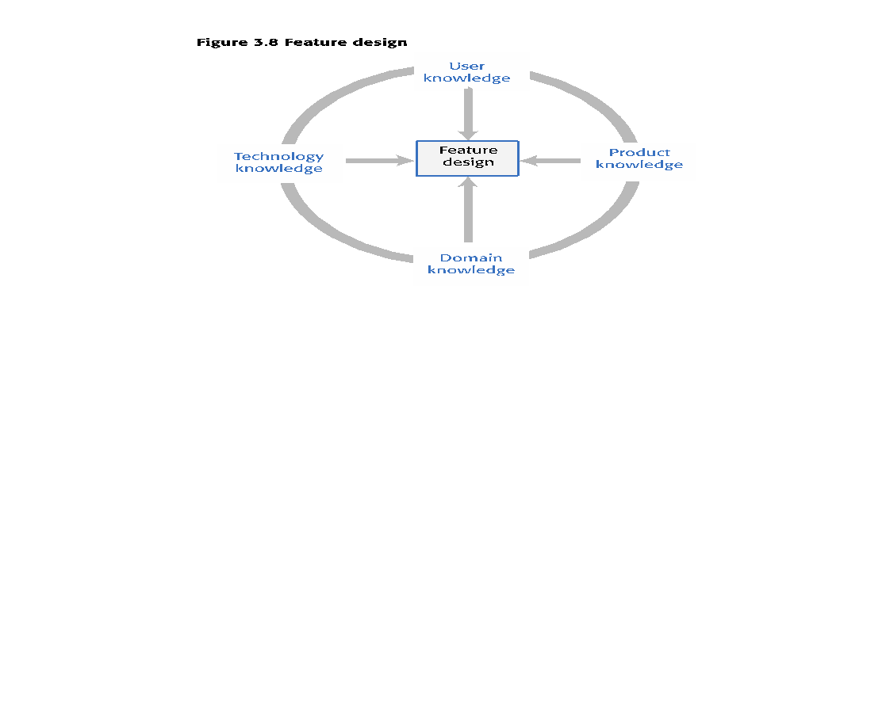
Figure 3.8 Feature design

Slide 123
Table 3.8 Knowledge required for feature design
User knowledge You can use user scenarios and user stories to inform the team of what users want and how they might use it the software features.
Product knowledge You may have experience of existing products or decide to research what these products do as part of your development process. Sometimes, your features have to replicate existing features in these products because they provide fundamental functionality that is always required.
Domain knowledge This is knowledge of the domain or work area(e.g. finance, event booking) that your product aims to support. By understanding the domain, you can think of new innovative ways of helping users do what they want to do.
Technology knowledge New products often emerge to take advantage of technological developments since their competitors were launched. If you understand the latest technology, you can design features to make use of it.

Slide 124
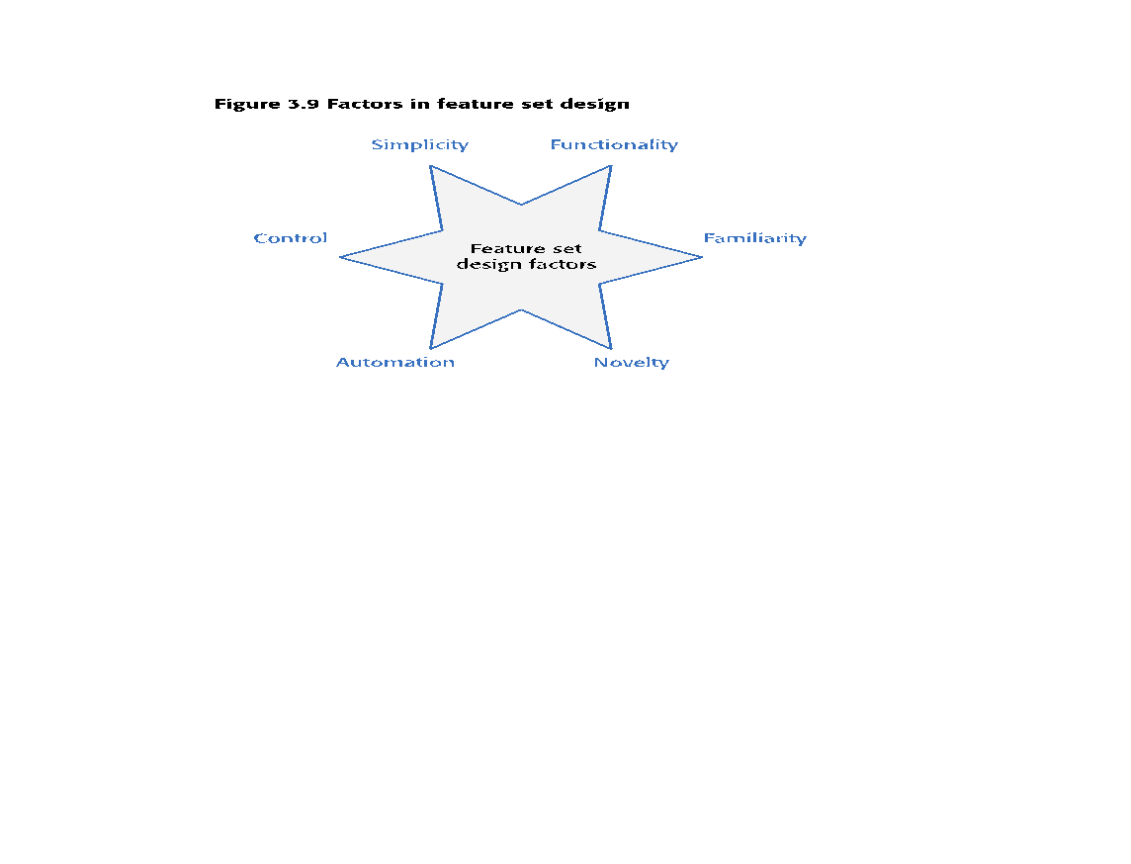
Figure 3.9 Factors in feature set design

Slide 125
Feature trade-offs
Simplicity and functionality
You need to find a balance between providing a simple, easy-to-use system and including enough functionality to attract users with a variety of needs.
Familiarity and novelty
Users prefer that new software should support the familiar everyday tasks that are part of their work or life. To encourage them to adopt your system, you need to find a balance between familiar features and new features that convince users that your product can do more than its competitors.
Automation and control
Some users like automation, where the software does things for them. Others prefer to have control. You have to think carefully about what can be automated, how it is automated and how users can configure the automation so that the system can be tailored to their preferences.

Slide 126
Feature creep
Feature creep occurs when new features are added in response to user requests without considering whether or not these features are generally useful or whether they can be implemented in some other way.
Too many features make products hard to use and understand
There are three reasons why feature creep occurs:
Product managers are reluctant to say ‘no’ when users ask for specific features.
Developers try to match features in competing products.
The product includes features to support both inexperienced and experienced users.

Slide 127
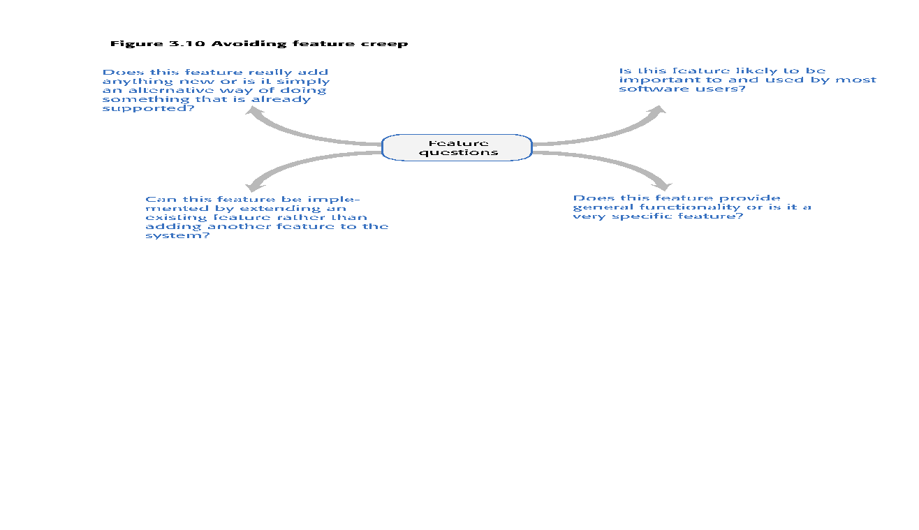
Figure 3.10 Avoiding feature creep

Slide 128
Feature derivation
Features can be identified directly from the product vision or from scenarios.
You can highlight phrases in narrative description to identify features to be included in the software.
You should think about the features needed to support user actions, identified by active verbs, such as use and choose.

Slide 129
Table 3.9 The iLearn system vision
FOR teachers and educators WHO need a way to help students use web-based learning resources and applications, THE iLearn system is an open learning environment THAT allows the set of resources used by classes and students to be easily configured for these students and classes by teachers themselves.
UNLIKE Virtual Learning Environments, such as Moodle, the focus of iLearn is the learning process itself, rather than the administration and management of materials, assessments and coursework. OUR product enables teachers to create subject and age-specific environments for their students using any web-based resources, such as videos, simulations and written materials that are appropriate

Slide 130
Features from the product vision
A feature that allows users to access and use existing web-based resources;
A feature that allows the system to exist in multiple different instantiations;
A feature that allows user configuration of the system to create a specific instantiation.

Slide 131
Table 3.10 Jack’s scenario with highlighted phrases
Jack is a primary school teacher in Ullapool, teaching P6 pupils. He has decided that a class project should be focused around the fishing industry in the area, looking at the history, development and economic impact of fishing.
As part of this, students are asked to gather and share reminiscences from relatives, use newspaper archives and collect old photographs related to fishing and fishing communities in the area. Students use an iLearn wiki to gather together fishing stories and SCRAN (a history archive) to access newspaper archives and photographs. However, Jack also needs a photo-sharing site as he wants pupils to take and comment on each others’ photos and to upload scans of old photographs that they may have in their families. He needs to be able to moderate posts with photos before they are shared, because pre-teen children can’t understand copyright and privacy issues.
Jack sends an email to a primary school teachers’ group, which he is a member of to see if anyone can recommend an appropriate system. Two teachers reply and both suggest that he uses KidsTakePics, a photo-sharing site that allows teachers to check and moderate content. As KidsTakePics is not integrated with the iLearn authentication service, he sets up a teacher and a class account with KidsTakePics.
He uses the the iLearn setup service to add KidsTakePics to the services seen by the students in his class so that when they log in, they can immediately use the system to upload photos from their phones and class computers.

Slide 132
Features from Jack’s scenario
A wiki for group writing.
Access to the SCRAN history archive. This is a shared national resource that provides access to historical newspaper and magazine articles for schools and universities.
Features to set up and access an email group.
A feature to integrate applications with the iLearn authentication service.

Slide 133
The feature list
The output of the feature identification process should be a list of features that you use for designing and implementing your product.
There is no need to go into a lot of detail about the features at this stage. You add detail when you are implementing the feature.
You can describe features using a standard input-action-output template by using structured narrative descriptions or by a set of user stories.

Slide 134
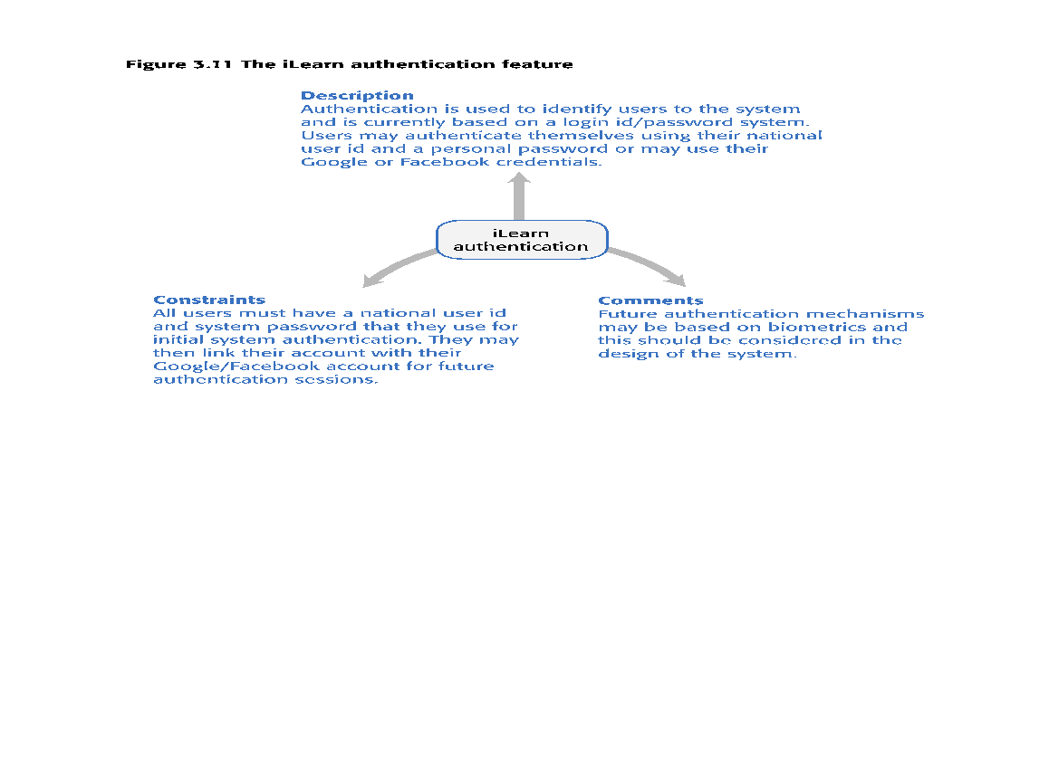
Figure 3.11 The iLearn authentication feature

Slide 135
Table 3.11 Feature description using user stories
Description As a system manager, I want to create and configure an iLearn environment by adding and removing services to/from that environment so that I can create environments for specific purposes.
As a system manager, I want to set up sub-environments that include a subset of services that are included in another environment.
As a system manager, I want to assign administrators to created environments.
As a system manager, I want to limit the rights of environment administrators so that they cannot accidentally or deliberately disrupt the operation of key services.
As a teacher, I want to be able to add services that are not integrated with the iLearn authentication system.
Constraints The use of some tools may be limited for license reasons so there may be a need to access license management tools during configuration.
Comments Based on Elena’s and Jack’s scenarios

Slide 136
Innovation and feature identification
Scenarios and user stories should always be your starting point for identifying product features.
Scenarios tell you how users work at the moment. They don’t show how they might change their way of working if they had the right software to support them.
Stories and scenarios are ‘tools for thinking’ and they help you gain an understanding of how your software might be used. You can identify a feature set from stories and scenarios.
User research, on its own, rarely helps you innovate and invent new ways of working.
You should also think creatively about alternative or additional features that help users to work more efficiently or to do things differently.

Slide 137
Key points 1
A software product feature is a fragment of functionality that implements something that a user may need or want when using the product.
The first stage of product development is to identify the list of product features in which you identify each feature and give a brief description of its functionality.
Personas are ‘imagined users’ where you create a character portrait of a type of user that you think might use your product.
A persona description should ‘paint a picture’ of a typical product user. It should describe their educational background, technology experience and why they might want to use your product.
A scenario is a narrative that describes a situation where a user is accessing product features to do something that they want to do.

Slide 138
Key points 2
Scenarios should always be written from the user’s perspective and should be based on identified personas or real users.
User stories are finer-grain narratives that set out, in a structured way, something that a user wants from a software system.
User stories may be used as a way of extending and adding detail to a scenario or as part of the description of system features.
The key influences in feature identification and design are user research, domain knowledge, product knowledge, and technology knowledge.
You can identify features from scenarios and stories by highlighting user actions in these narratives and thinking about the features that you need to support these actions.

